Slide 1


Waste Sorting Using Computer Vision
College Name
Student names

Slide 2
Problem Statement
Brief Overview:
Waste management is a crucial component of environmental sustainability. The improper sorting of waste at recycling facilities reduces the efficiency of recycling processes, leading to increased landfill waste and environmental harm. Traditional manual sorting methods are labor-intensive, costly, and prone to human error. To address this issue, artificial intelligence (AI) and machine learning, particularly computer vision, can be leveraged to automate and enhance the accuracy of waste classification.
Key Objectives:
Automate waste sorting using AI-driven computer vision.
Improve recycling efficiency and reduce errors in waste classification.
Minimize reliance on manual labor, reducing operational costs.
Enhance the differentiation of various waste types, including plastic variations.
Source :
www.freepik.com/

Slide 3
Dataset Overview(Optional)
Dataset Description:
The dataset used for this AI model contains labeled images of various waste types, including:
Plastic (PET, HDPE, and other types)
Glass
Metal
Paper
Each category consists of images that help train the model to distinguish between different waste types accurately.
Source :
www.freepik.com/

Slide 4
Methodology
Approach:
Data Preprocessing: Image resizing, normalization, and augmentation to improve model learning.
Model Training: Using Convolutional Neural Networks (CNNs) to classify waste categories.
Evaluation & Optimization: Fine-tuning the model for higher accuracy and efficiency.
Algorithms Used:
Convolutional Neural Networks (CNNs): Extracting features for image classification.
Spectral Imaging: Analyzing material composition to differentiate waste types.
Multi-Modal Learning: Combining image data with additional material properties for better classification.
Source :
www.freepik.com/

Slide 5
SOURCE CODE

Slide 6


Slide 7


Slide 8


Slide 9
OUTPUT

Slide 10
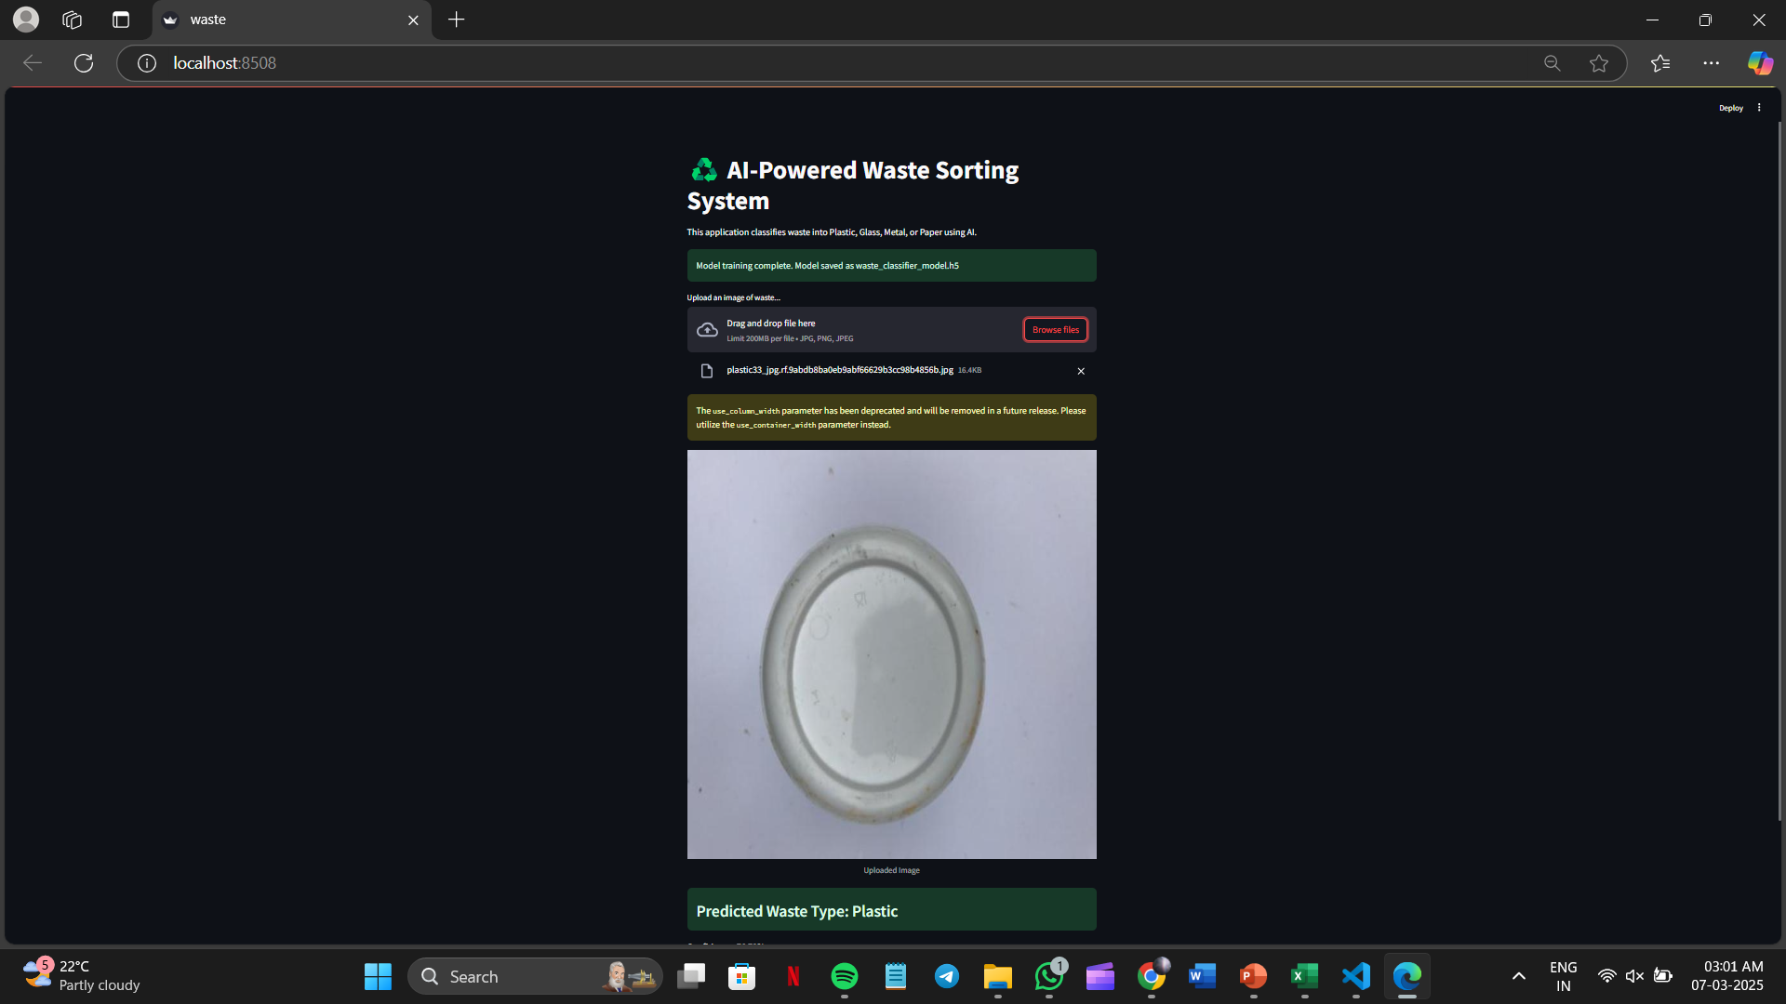

Slide 11

Conclusion
Summary:
AI-driven waste sorting has shown significant improvements in efficiency, accuracy, and cost reduction. Future advancements can focus on differentiating between various plastic types, expanding the dataset, and scaling the system to multiple recycling centers to enhance waste management globally
Future Work:
Improve the model’s ability to differentiate between various plastic types using advanced spectral imaging.
Expand the dataset to include more diverse waste categories for better generalization.
Optimize the AI system for real-time waste sorting in large-scale recycling facilities.
Source :
www.freepik.com/

Slide 12
References
Research Papers on AI in Waste Management: IEEE Xplore, Springer, and ScienceDirect
Case Study on Sweden’s AI-Powered Recycling: Government reports and sustainability journals
TensorFlow & Keras Documentation for CNN Implementation: www.tensorflow.org and keras.io
AI and Waste Management Blogs: Towards Data Science, Medium AI publications
Source: www.freepik.com

Slide 13
Thank You
Notes:
Thank You !!

